Slide 1
Weekly report: Tower structure
Week number: 07
Date: 11/11/2025
Supervisor: Prof. Faber
Group members: Ibrahim Mostafa, Mohammed Eldemerdash, Kirollos Ghaly
Speaker: Kirollos Ghaly (760171)
11/11/2025
1
Group members: Ibrahim Mostafa, Mohammed Eldemerdash, Kirolls Ghaly
Tower structure team/ Optimus Syria

Slide 2
List of contents
Calculate the eigenfrequency manually.
Calculate the eigenfrequency using the ANSYS program.
11/11/2025
Group members: Ibrahim Mostafa, Mohammed Eldemerdash, Kirolls Ghaly
Tower structure team/ Optimus Syria

Slide 3
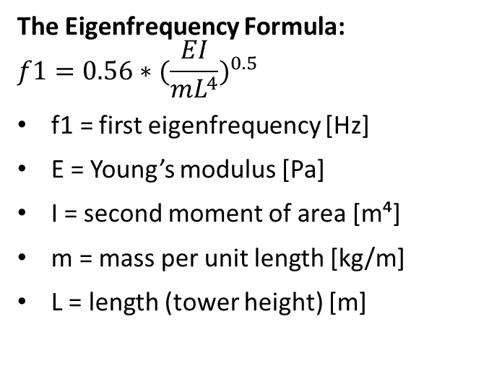
Calculate the eigenfrequency manually
The Eigenfrequency Formula:
$$f1=0.56∗{(\frac{EI}{mL^{4}})}^{0.5}$$
f1​ = first eigenfrequency [Hz]
E = Young’s modulus [Pa]
I = second moment of area [m⁴]
m = mass per unit length [kg/m]
L = length (tower height) [m]
11/11/2025
Group members: Ibrahim Mostafa, Mohammed Eldemerdash, Kirolls Ghaly
Tower structure team/ Optimus Syria

Slide 4
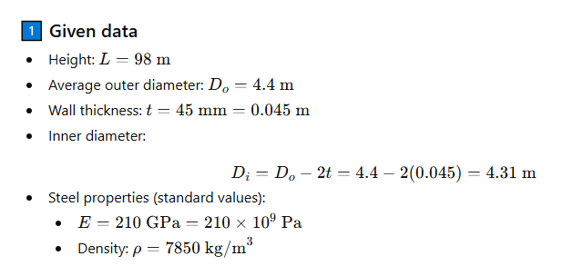
Calculate the eigenfrequency manually
11/11/2025
Group members: Ibrahim Mostafa, Mohammed Eldemerdash, Kirolls Ghaly
Tower structure team/ Optimus Syria

Slide 5
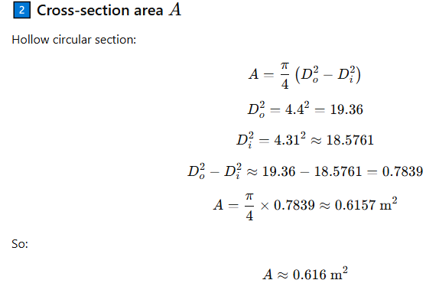
Calculate the eigenfrequency manually
11/11/2025
Group members: Ibrahim Mostafa, Mohammed Eldemerdash, Kirolls Ghaly
Tower structure team/ Optimus Syria

Slide 6
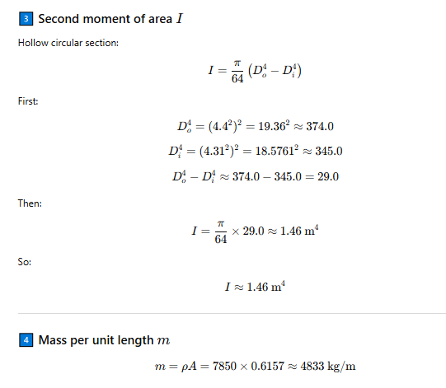
Calculate the eigenfrequency manually
11/11/2025
Group members: Ibrahim Mostafa, Mohammed Eldemerdash, Kirolls Ghaly
Tower structure team/ Optimus Syria

Slide 7
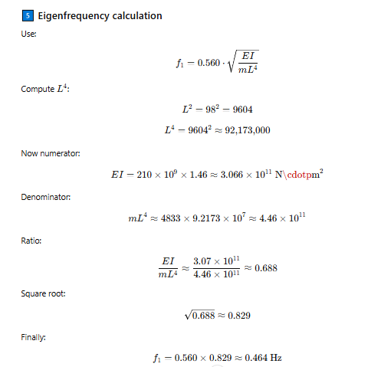
Calculate the eigenfrequency manually
11/11/2025
Group members: Ibrahim Mostafa, Mohammed Eldemerdash, Kirolls Ghaly
Tower structure team/ Optimus Syria

Slide 8
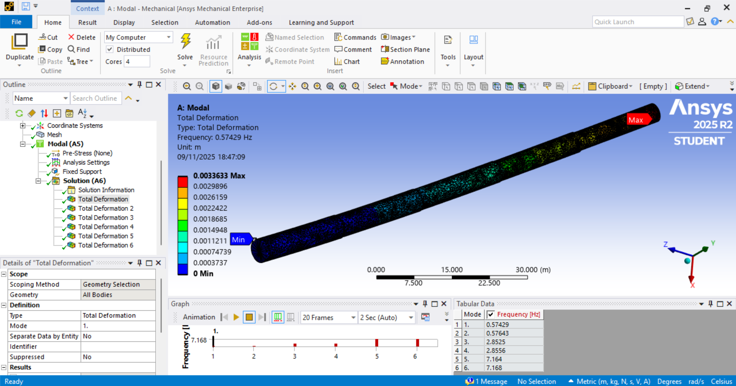
Calculate the eigenfrequency using the ANSYS program
11/11/2025
Group members: Ibrahim Mostafa, Mohammed Eldemerdash, Kirolls Ghaly
Tower structure team/ Optimus Syria

Slide 9
Calculate the eigenfrequency using the ANSYS program
The eigenfrequency refers to the ANSYS program:
f1​ = 0.574 Hz
The difference between the program and the manual calculation is only 18%, so it is acceptable.
11/11/2025
Group members: Ibrahim Mostafa, Mohammed Eldemerdash, Kirolls Ghaly
Tower structure team/ Optimus Syria

